Slide 1


t
Introduction to FDI in India
Foreign Direct Investment (FDI) significantly contributes to India's economic growth. Between 2000 and 2017, India attracted substantial FDI inflows, becoming one of the top destinations globally.
by Naman Kedia

Slide 2
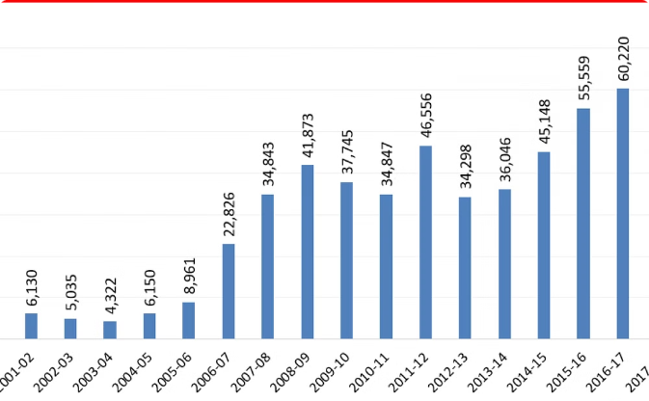
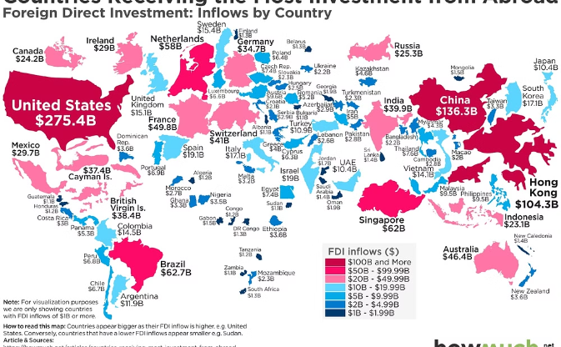
FDI Trends in India (2000-2017)
Steady Growth
Peaks and Troughs
FDI inflows to India grew consistently, reflecting increased investor confidence.
Certain years witnessed spikes due to policy changes and global economic conditions.
1
2000-2005
Initial reforms led to increasing FDI interest.
2
2006-2011
Significant peaks were noted, guided by liberal policies.
3
2012-2017
Despite fluctuations, India remained attractive for investors.

Slide 3
Sectoral Analysis of FDI Inflows
Services Sector
Telecommunications
Manufacturing
This sector topped FDI inflows, supported by economic growth and consumer demand.
Telecom sector reforms attracted investments, driven by digitization.
Government initiatives like 'Make in India' boosted foreign investments.

Slide 4

Top Investing Countries
Country
FDI Inflows (USD billion)
Percentage Share
United States
40
20%
Singapore
35
18%
United Kingdom
30
15%

Slide 5

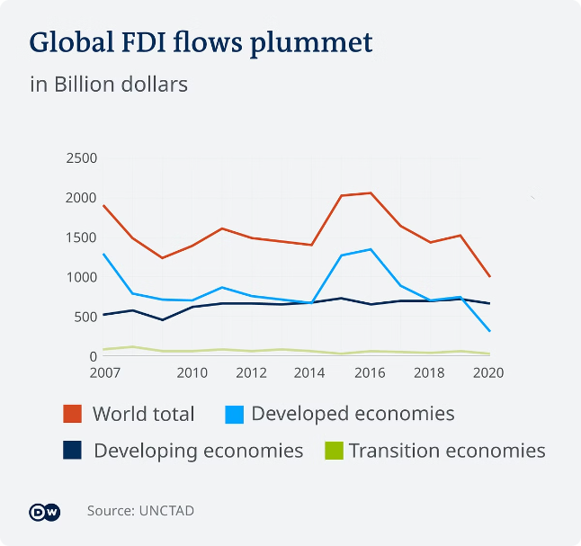
Regional Distribution of FDI
1
Western India
2
Southern India
Leading in FDI, particularly in services and manufacturing.
Emerging technology hubs draw significant investments.
3
Northern India
Infrastructure projects attract FDI, improving connectivity.

Slide 6


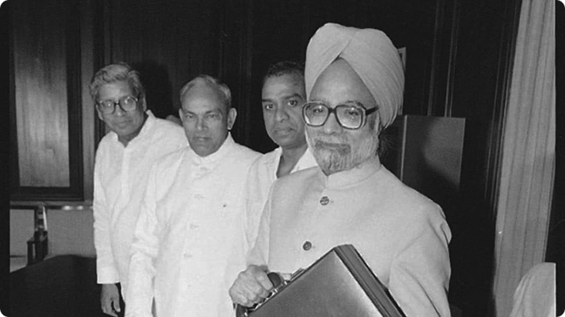


Policy Reforms and their Impact
Key Policy Changes
Liberalization in FDI norms improved investment climate.
Make in India Initiative
Stimulated manufacturing and attracted global investments.
Ease of Doing Business
Improvements in this metric elevated investor confidence.

Slide 7

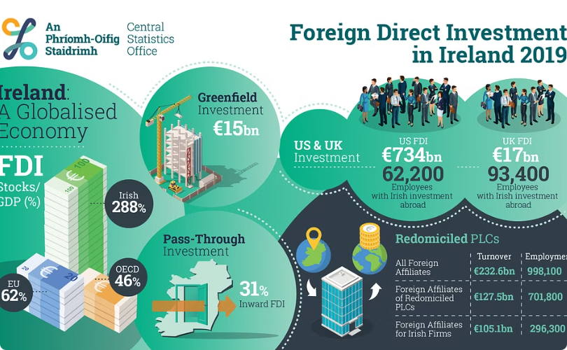
Challenges and Opportunities
Challenges
Opportunities
Regulatory hurdles and political instability deter investments.
Emerging sectors present promising avenues for foreign investors.
Global Competitiveness
Innovation Ecosystem
Strengthening India's position as a global investment hub.
Fostering innovation through collaborations between domestic and foreign firms.

Slide 8

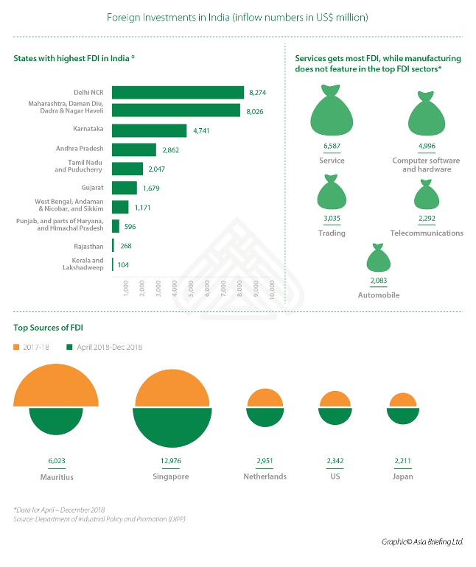
Conclusion and Key Takeaways
India's FDI journey from 2000-2017 shows resilience and adaptability. Strong policy frameworks and diverse sectors make it an attractive destination.

